Slide 1
SPCD fMRI results lab meeting
Qingfang Liu
June 18, 2026

Slide 2
Behavioral results suggest that preconditioned cues carry information about reward identity. Here, we ask:
where is reward identity represented in the brain?
whether it overlaps with conditioned-cue representations
We focus specifically on lateral OFC, given prior evidence that it (1) represents odor identity for directly learned cues and (2) supports inferential behavior.

Slide 3
Analysis: pre-meal RSA using odor-predictive cues only, excluding clean-air cues.
Neural RDM ~ odor identity RDM + button RDMs
Image-wise beta estimates were derived from the probe task in the pre-meal and post-meal sessions using LSS.
The neural RDM was then regressed onto odor-group and button-response model RDMs.
This is conducted for conditioned cues and preconditioned cues, separately.

Slide 4
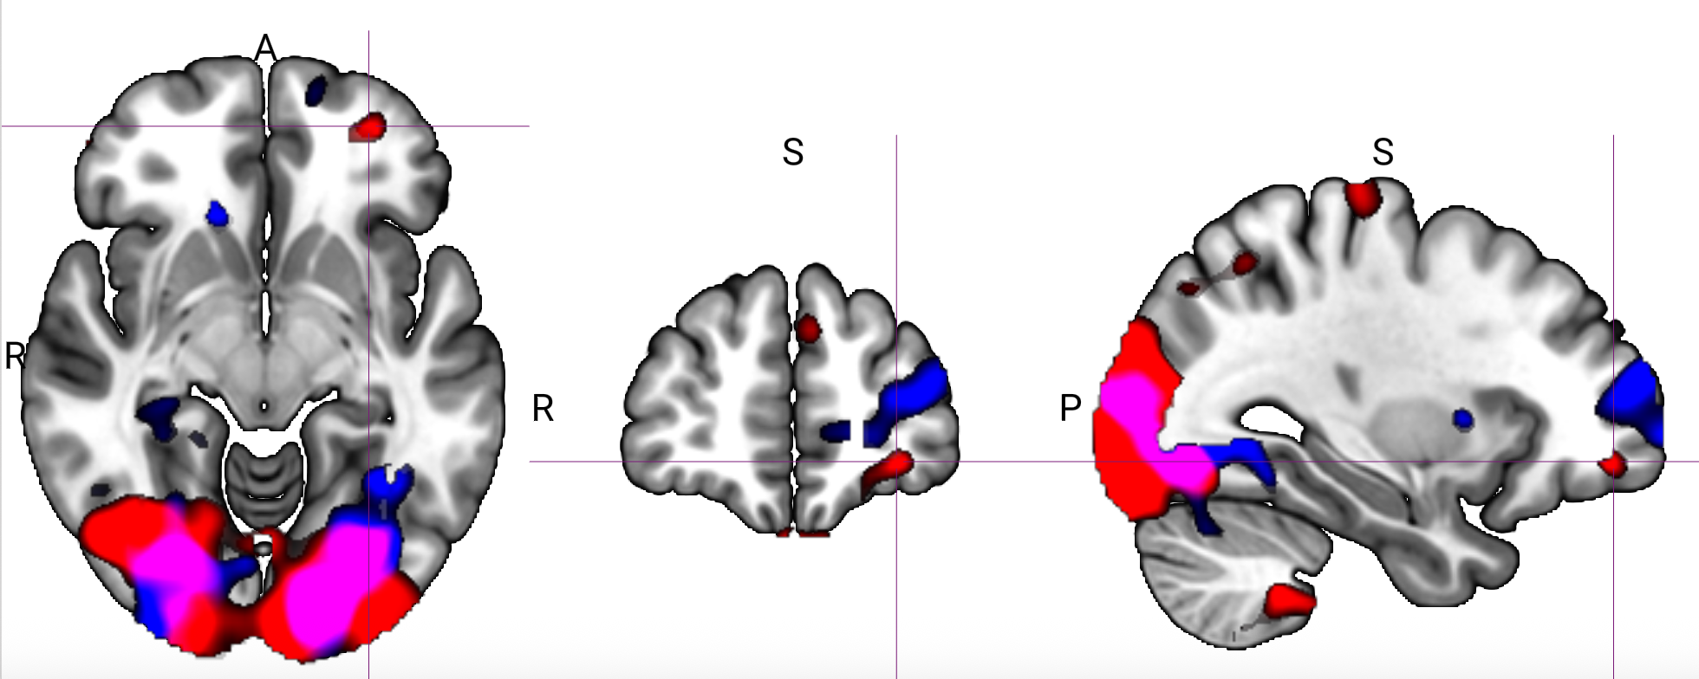
Conditioned and preconditioned cues showed partially distinct spatial patterns of reward-identity encoding.
Red: preconditioned cues.
Blue: conditioned cues.
Notes:
2-2.5
Without having image identity RDM regressor

Slide 5
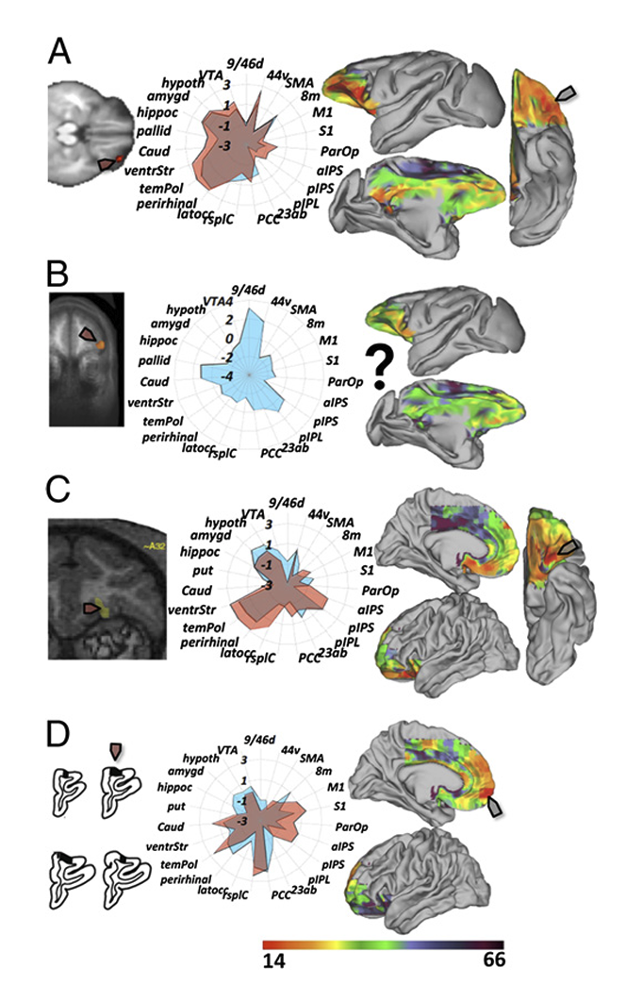
ROI-based analysis on reward identity representation
ROI analysis focused on OFC parcels from the Neubert 2015 parcellation.
Conditioned cues showed a trend in Left 14m, t(31) = 1.99, p = 0.055.
Preconditioned cues showed an effect in Right 11m, t(31) = 2.16, p = 0.038.

Slide 6
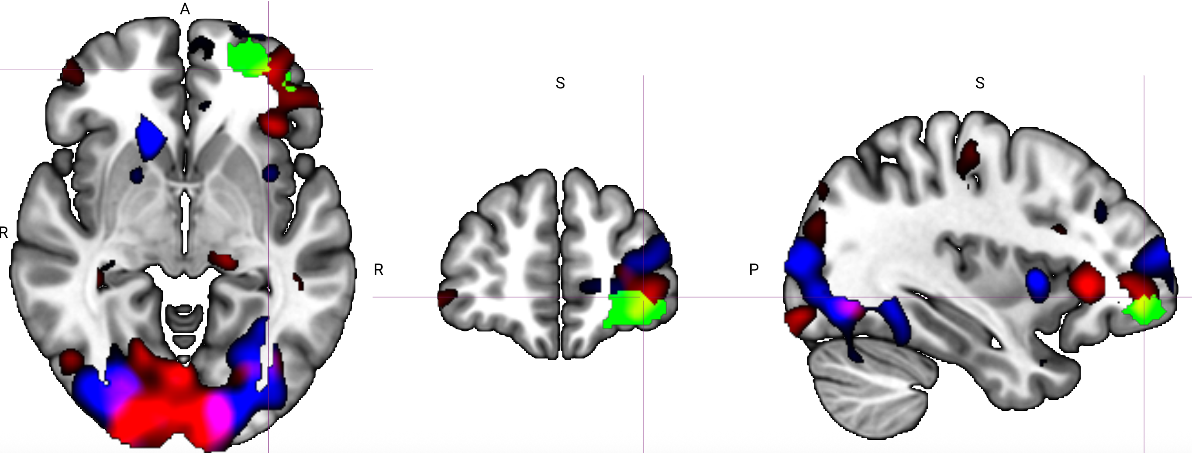
What if we only rely on the first images per trial?
Notes:
[-34, 50, -4]
Threshold at 2-3
Green is left 47m threshold at 50
This seems to suggest that with both conditioned and preconditioned cues, lateral OFC is representing odor identity of preconditioned cues, rather than conditioned cues

Slide 7
Neural RDM ~ odor identity RDM + visual image RDM + button RDMs
Two ways of building visual image RDM
  Fixed visual cortex mask
  Using searchlight local information from localizer data

Slide 8
Neural RDM ~ odor identity RDM + cue type RDM + image identity RDM + button RDMs

Slide 9
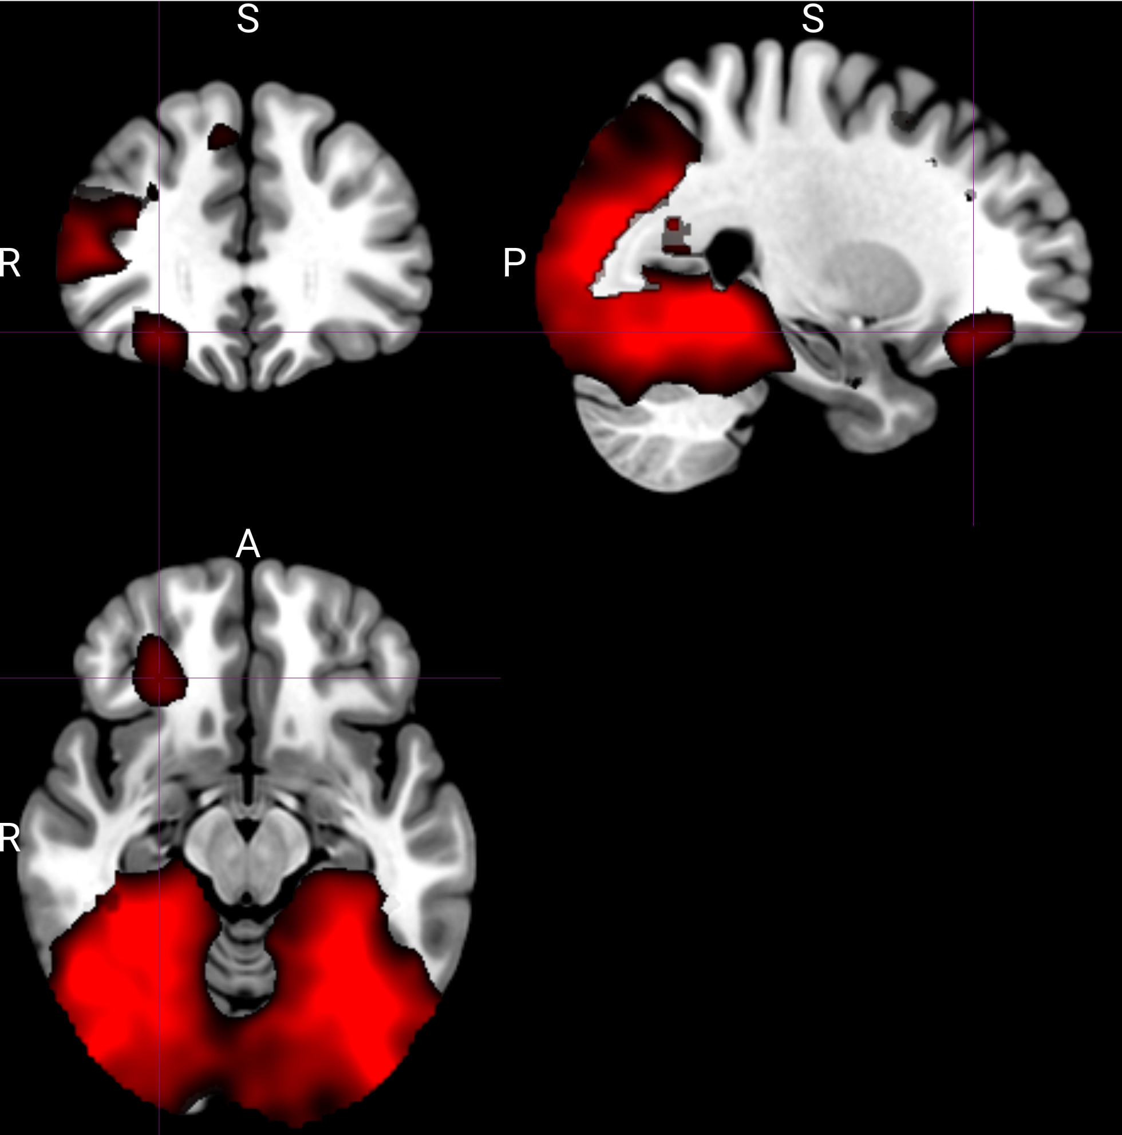
Different representation of cue-type (conditioned vs. preconditioned) identified from RSA
Data from across pre-meal and post-meal
Notes:
Thresholded at >3

Slide 10
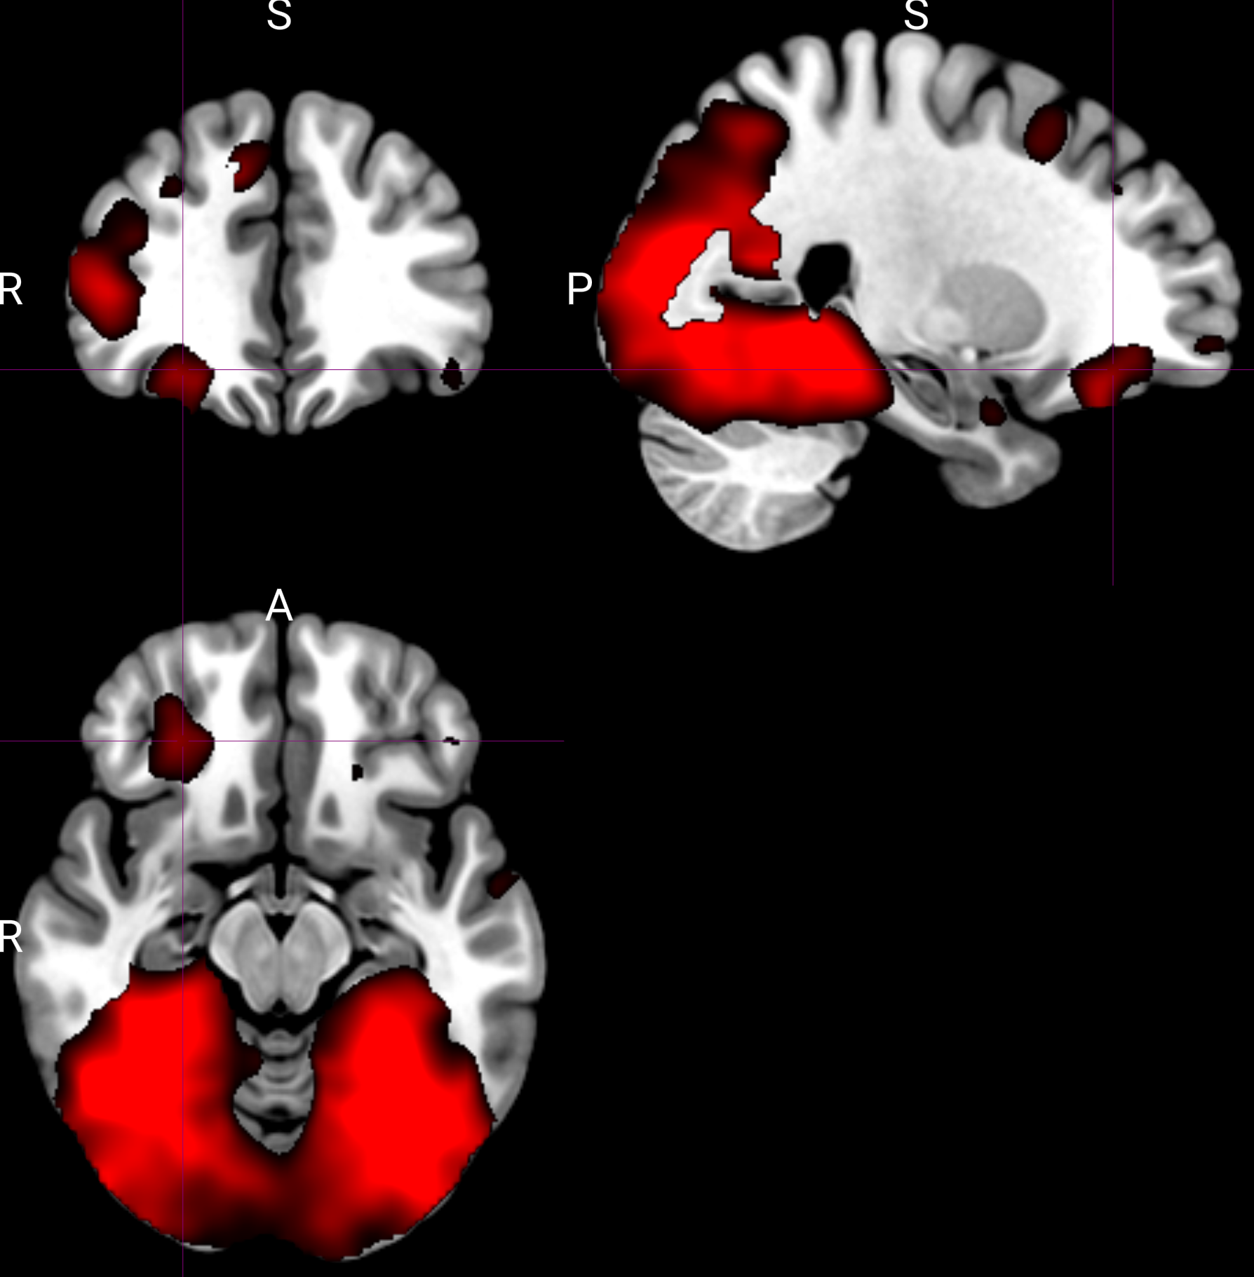
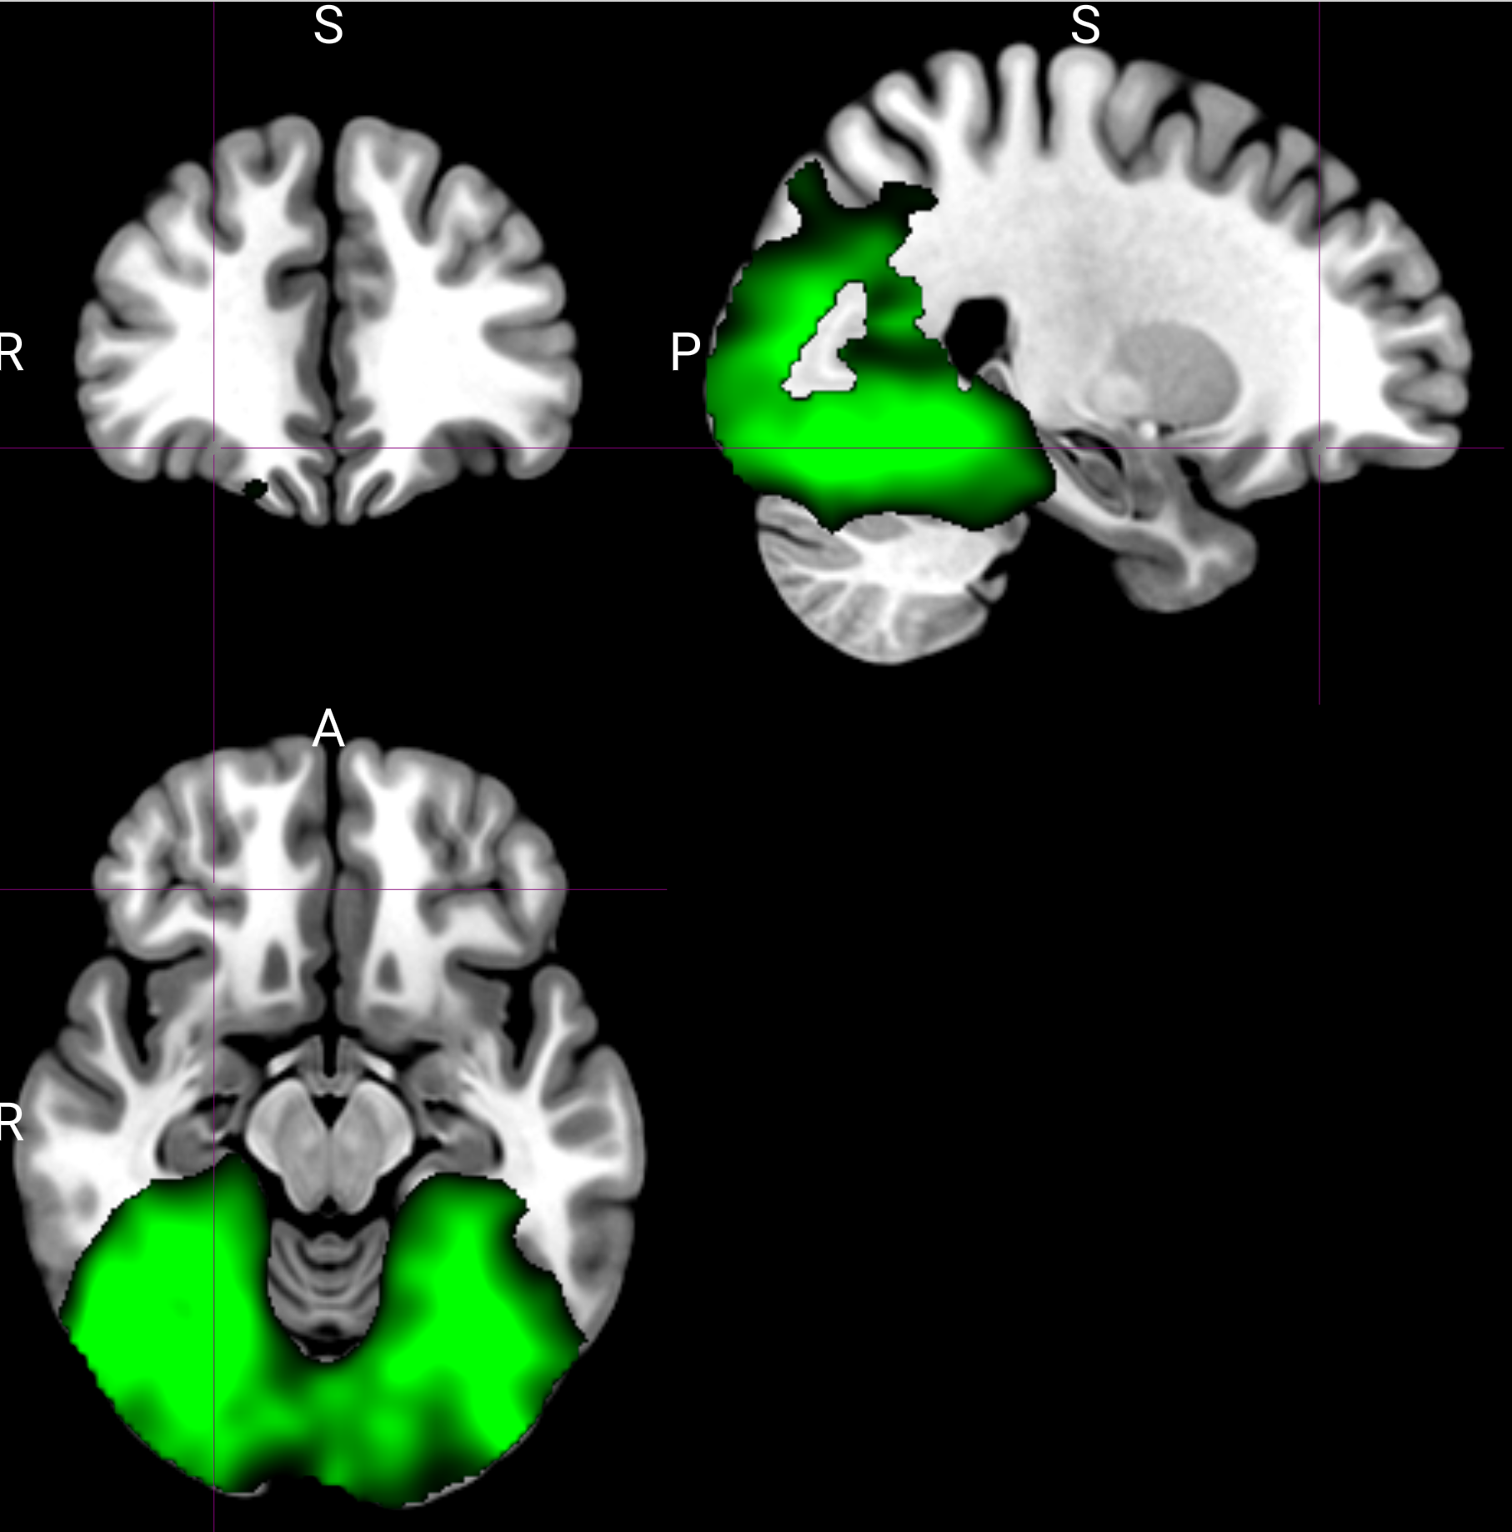
Comparing cue-type representation pre-meal (red) and post-meal (green)
Thresholded at >3 (26, 36, -14)

Slide 11
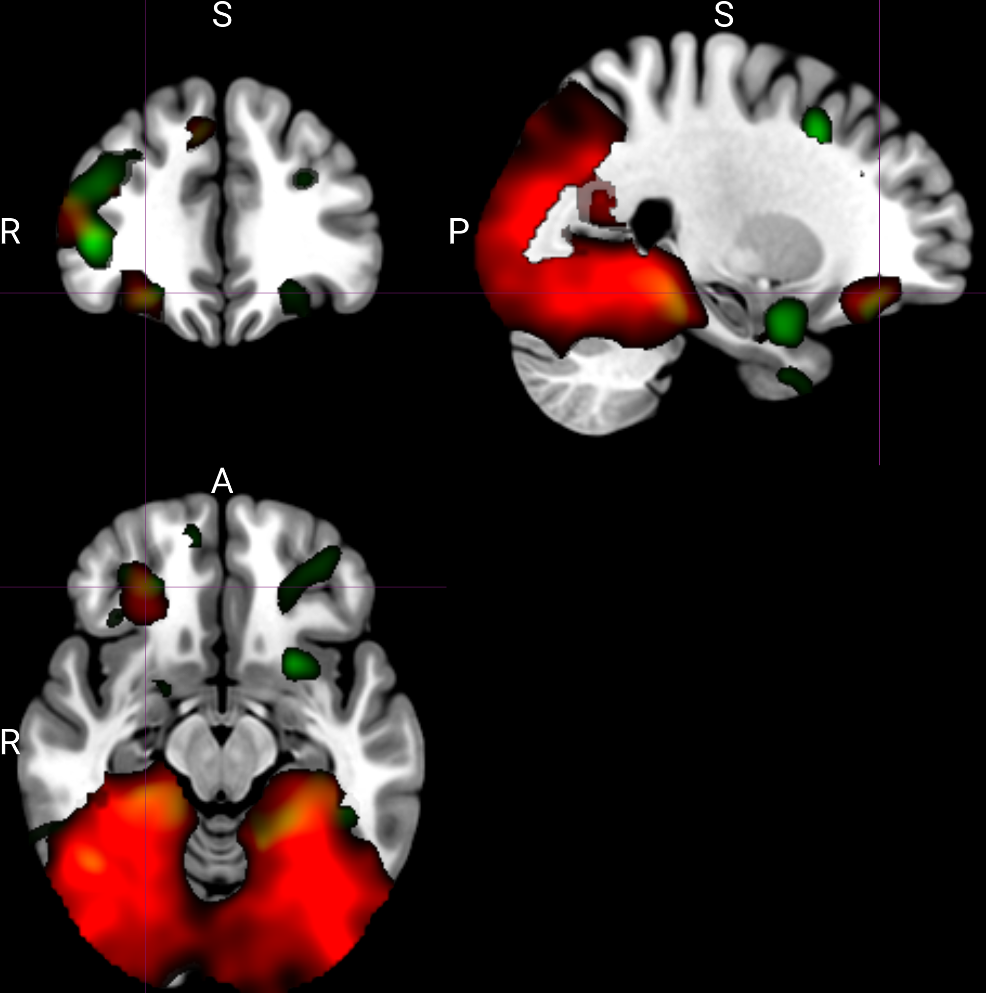
Cue-type representations decreased from pre- to post-meal.
Green shows the pre-to-post decrease, thresholded at t > 2 and overlaid on the cue-type map in red.

Slide 12
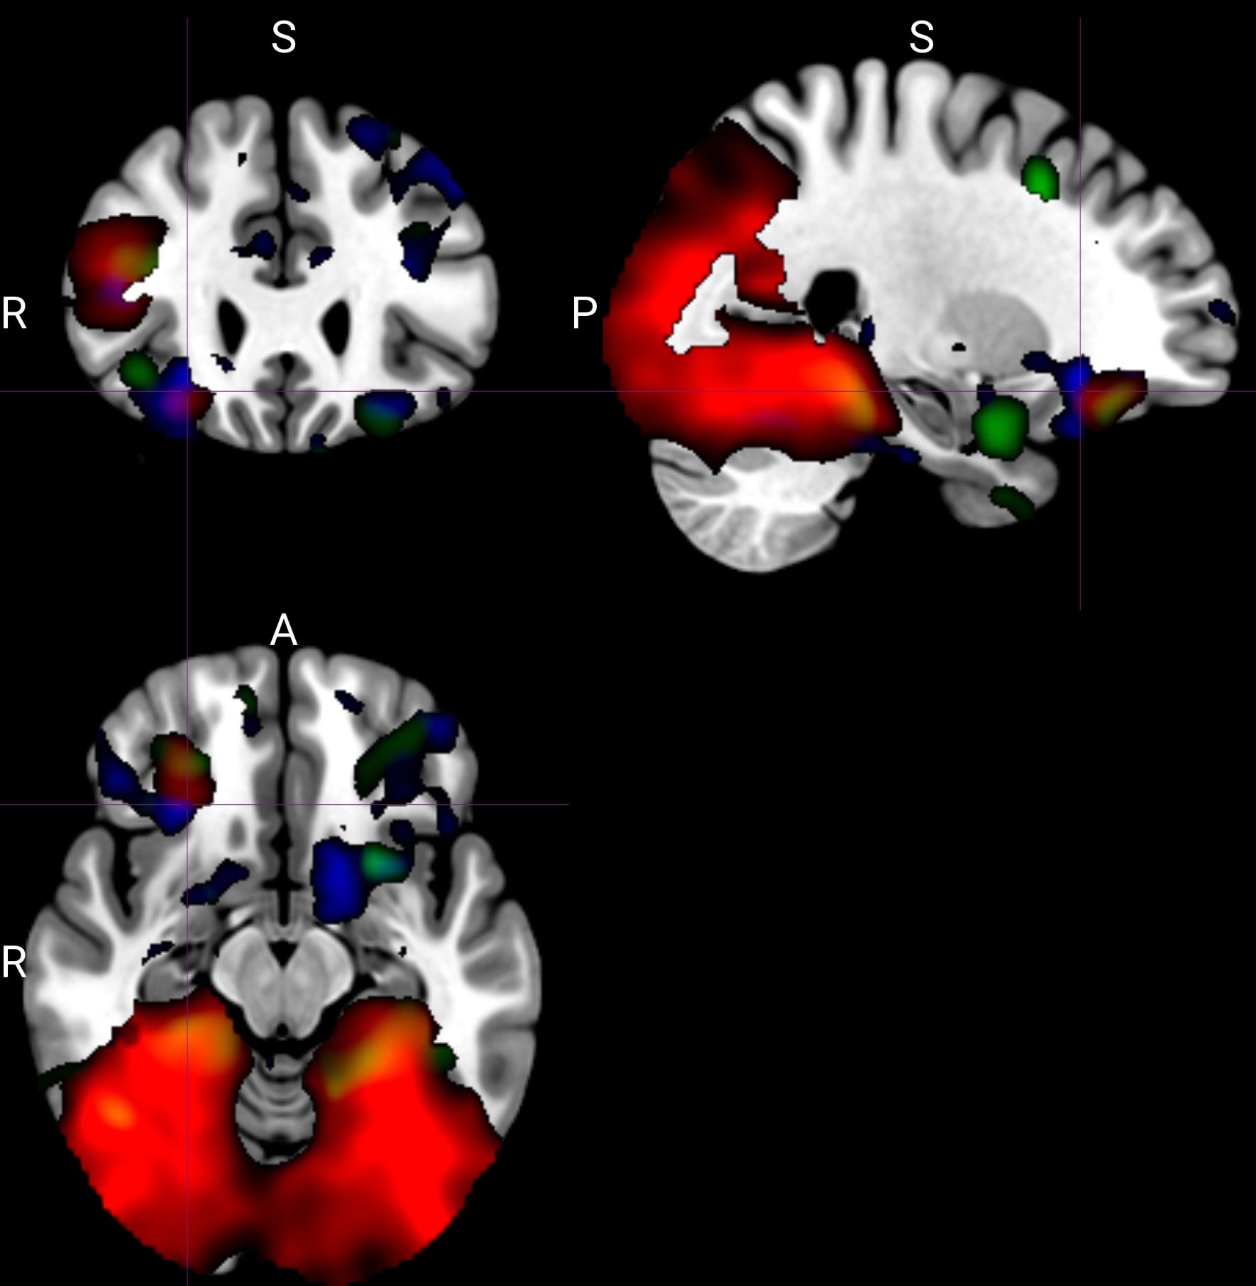
Univariate analysis showed stronger responses to preconditioned than conditioned cues in several regions.
Blue clusters are thresholded at t > 2.

Slide 13
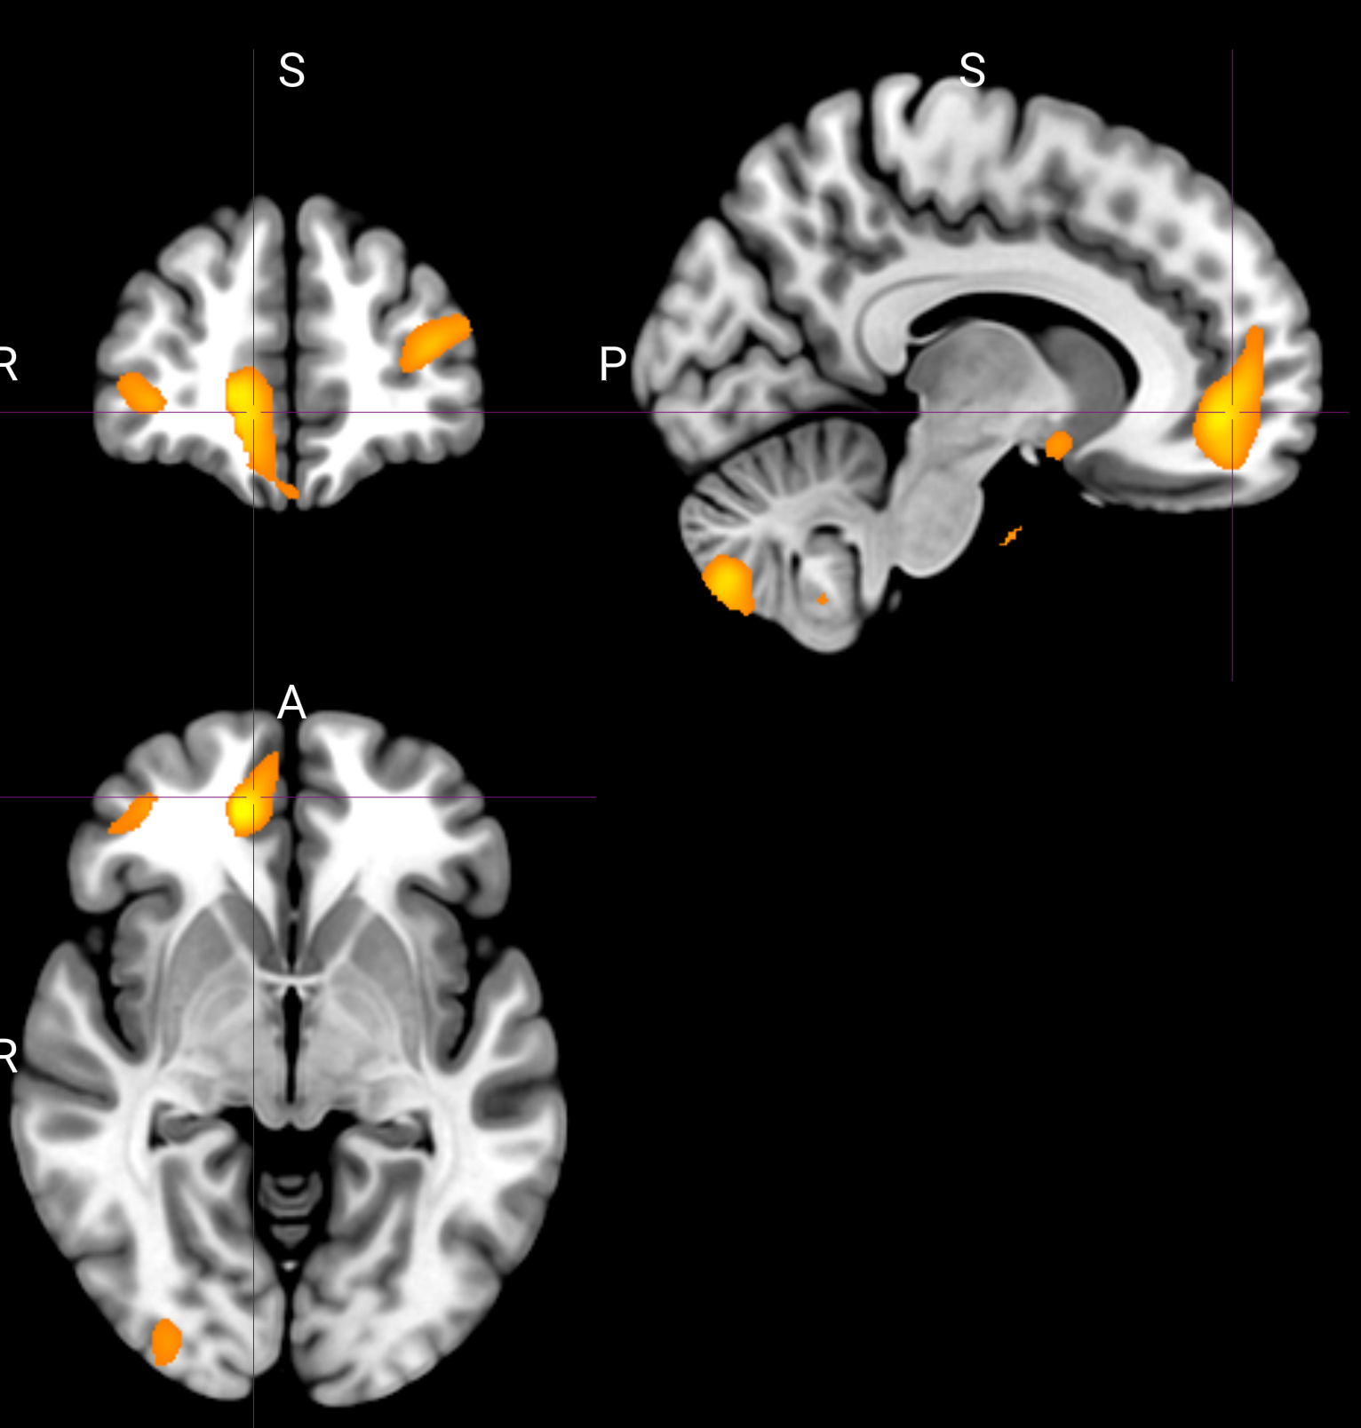
Value representation
Linked odor pleasantness ratings as a proxy for value
Use data across pre and post meals

Slide 14
Thank you!

